Slide 1
ALGEBRA 4
Day 42

Slide 2

Bell Work
Graph the following. Is it an example of a quadratic? Why or why not?
$$1.) y=−2x+4$$
$$2.) y=x^{2}−6x+8$$
$$3.) f\left(x\right)=\frac{1}{3}x^{2}−0.6x+π$$

Slide 3
Objective
Overview of Algebra 4
Quick Review of Algebra 3

Slide 4
Second Semester Break Down (3rd Quarter)
Week of Jan 9: Review Algebra 3 (specifically quadratics)
Week of Jan 15: Start Polynomial Unit
Week of Jan 22: Polynomials
Week of Jan 29: Polynomials
Week of Feb 5: Finish Polynomials
Week of Feb 12: Polynomial Test & Grade Checks
Week of Feb 19: Start Probability Unit
Week of Feb 26: Prob
Week of Mar 5: Finish Prob and Test
---End 3rd Quarter---

Slide 5
Second Semester Break Down (4th Quarter)
Week of Mar 12: Spring Break
Week of Mar 19: Start an ACT Unit: Pre; Elem; Interm. Algebra & Geometry
Week of Mar 26: ACT Unit: ACT & Strategies, Practice Exam
Week of Apr 2: Start Stats Unit (ACT TEST ON 4/3)
Week of Apr 9: Statistics
Week of Apr 16: Finish Stats and Test
Week of Apr 23: Start Exponential/Log Unit
Week of Apr 30: Logs
Week of May 7: Finish Logs and Test (SENIOR FINALS)
Week of May 14: Review for Finals
Week of May 21: Take Finals
---End 4th Quarter---

Slide 6
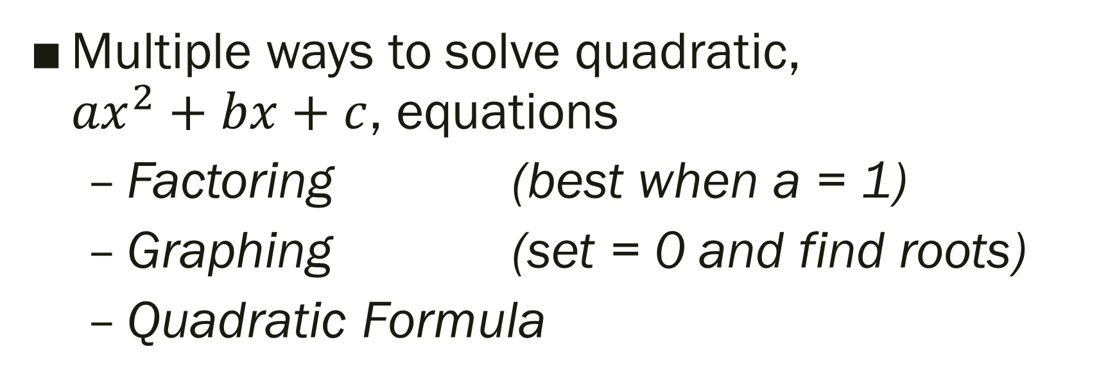
Quadratic Review
Multiple ways to solve quadratic, ${ax}^{2}+bx+c$, equations
Factoring (best when a = 1)
Graphing (set = 0 and find roots)
Quadratic Formula

Slide 7
The Quadratic Formula;
The solutions of the quadratic equation
ax² + bx + c = 0 are:
-- Can be used to solve any quadratic equation (instead of factoring or graphing)
--Must be in standard form; ax² + bx + c = 0

Slide 8

Solve:
1.) $5x^{2}= 20$
2.) x² + x = 6
3.) 3x² – 17x + 10 =0
4.) $\text{x}\text{2}\text{ = −9 }$

Slide 9
For Next Time
Page 245 #11 – 23 (odd), 38
Page 253 #39, 43

